Slide 1
Employment Rights Bill
Fire & rehire and preparing for 2026
Innes Clark & Lindsey Cartwright
MFMac Employment Law Team
13 November 2025
Notes:
Hello and thank you very much for joining our webinar today on the Employment Rights Bill.
For those who have not joined before, my name is Innes Clark, I head up the employment law team at Morton Fraser MacRoberts.
I'm joined today by Lindsey Cartwright who is also a partner in the team. Lindsey has many years of experience of advising employers on a very wide range of employment law issues.
This is part 4 of our 4 part series on the Employment Rights Bill which we have been running this year focusing on different elements of the Bill. If you missed parts 1, 2 or 3 - you can find recordings on the Insights section of our website.
[SLIDE]

Slide 2
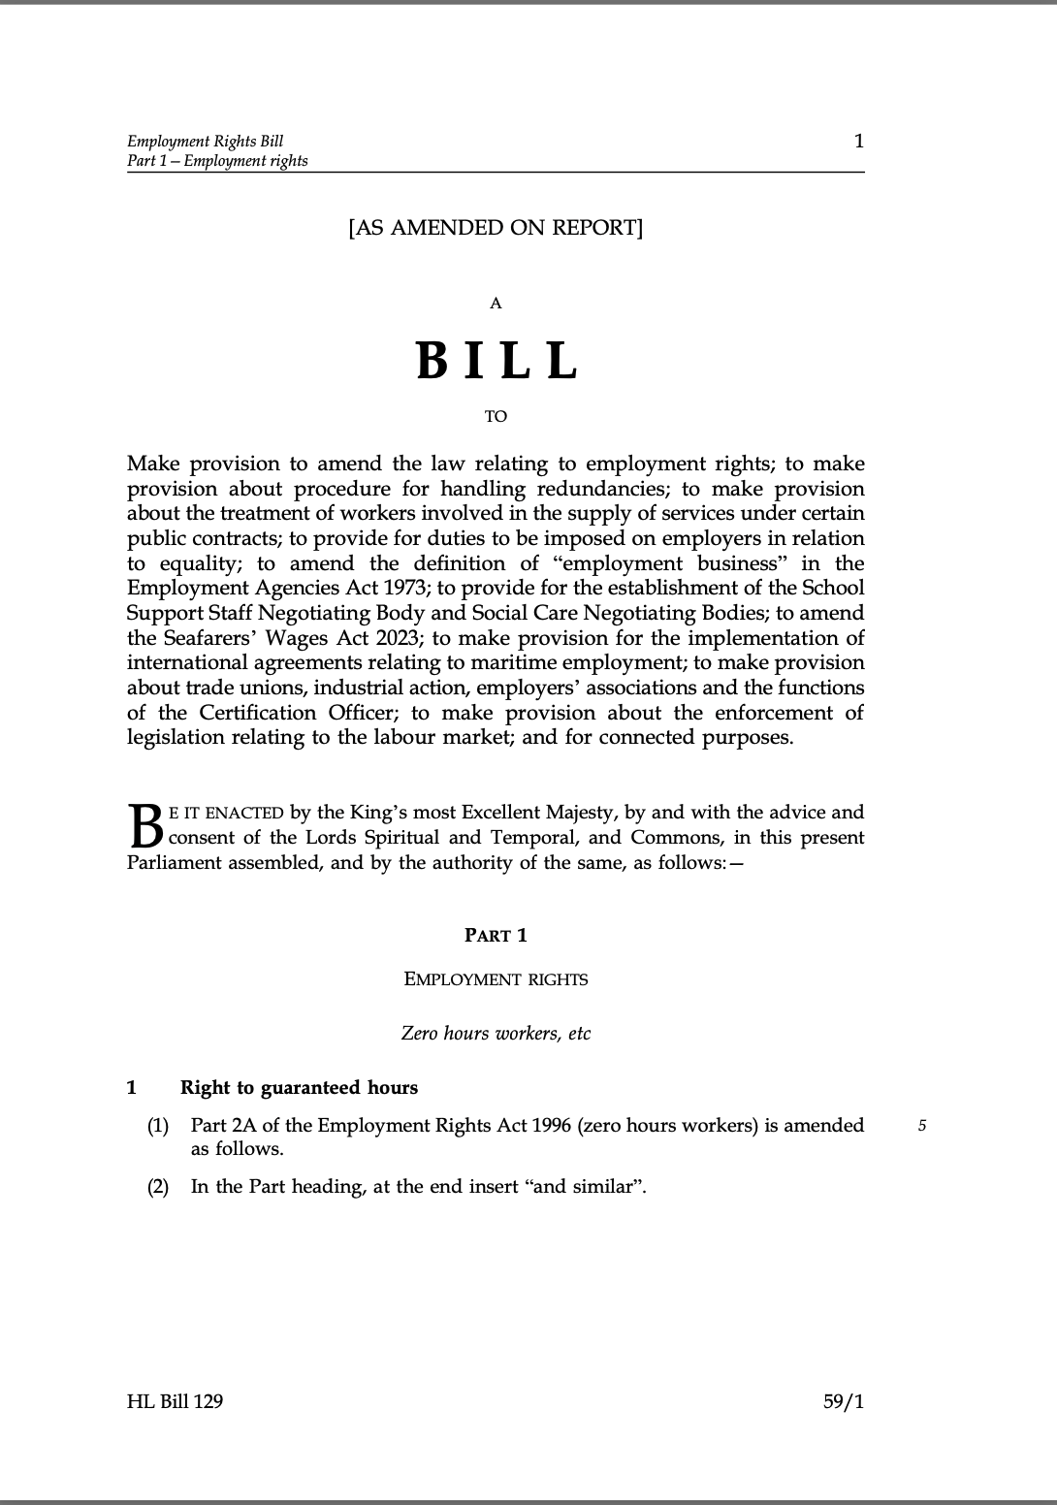
Employment Rights Bill
“Once-in-a-generation”
Day 1 right to unfair dismissal protection
Day 1 right to paternity, parental and bereavement leave and enhanced protections for pregnant women/new mothers
Right to guaranteed hours and compensation for zero/low hours workers
Strengthened protections against fire and rehire and changes to collective consultation
Updated industrial relations framework
Notes:
We are now getting very close to the Employment Rights Bill coming into force. For those less familiar with the Bill, just a reminder that it was a key part of Labour’s election manifesto and it has been described repeatedly as a once in a generation overhaul of employment rights.
In terms of its impact, it far exceeds anything that Lindsey or I have seen over the past 30 years or so of our careers as employment lawyers.
It is an extremely far reaching piece of legislation which is very pro employee, very pro trade union and it will affect all employers.
I’ve highlighted on the slide some of the key provisions but there are many more.
One of the many issues with the Bill is that the Government created a rod for its own back when it promised the Bill within 100 days of coming into power. They achieved that but what we have is, in many cases, a framework only, with the detail of how something will work in practice subject to future consultation and future regulations.

Slide 3
What we will cover
Implementation update
Recent consultations
Fire and rehire
How do employers change terms and conditions going forward?
Getting ready for 2026
Notes:
In terms of what we will cover today………………………
Our focus today is on the fire and rehire provisions and the implications for employers when it comes to changing terms and conditions of employment but we will also:-
Bring you right up to speed with where we currently are with the Employment Rights Bill and when it is expected to come into force.
We will also look at what employers should be doing in order to get ready for the many changes expected next year.
As usual there will be time at the end for your questions and when it comes to question, please use the question function which allows you to ask your question anonymously.
Finally, a reminder that this webinar is applicable to the law of Scotland, England and Wales and we will send on a recording of the webinar and the slides in the coming days.

Slide 4

Implementation update
Ping pong
House of Lords and House of Commons disagreeing on:-
day 1 unfair dismissal rights
an opt out for guaranteed hours
treatment of seasonal workers in guaranteed hours scheme
enrolment of union members to contribute to political funds
50% turnout requirement for industrial action ballots
Notes:
So, where are we as of today?
We are still in the “ping pong” phase - and that is actually the technical term used – the Bill is currently ping ponging between the House of Lords and the House of Commons. The reason for this is that the House of Lords and House of Commons are not currently agreeing on certain provisions of the bill. The disagreement relates to the points on the slide:-
day 1 unfair dismissal rights was one of the key Labour manifesto promises in relation to employment rights – the Bill envisages a day 1 right with a statutory 9 month probationary period, with special rules to apply during that probationary period. The HOL want to simplify matters by just having a 6 month qualifying period. This makes a lot of sense but unlikely that that Government will move on this given their clear manifesto pledge to make this a day 1 right
the Bill contains some incredibly complicated provisions relating to guaranteed hours for zero hour or low hour workers – another manifesto pledge - first 15 or so pages of the Bill deals with this. The House of Lords want an opt out provision for employees who are content with their current hours of work
The House of Lords also wanted an amendment requiring the Secretary of State to take account of seasonal workers in the guaranteed hours scheme – one of the criticisms at the moment is that, for example, seasonal workers working long hours in the run up to Christmas, would have to be offered the same long hours in January which does not make any sense from a business perspective.
The Bill introduces automatic enrolment for union members to contribute to the union’s political funds. As you may know, unions use their political funds to campaign on political issues that matter to their members. The Bill envisages that trade union members can opt out of this but the House of Lords want to reverse that so that a trade union member needs to opt in rather than this being automatic.
Finally, the House of Lords want the retention of a 50% turnout requirement for industrial action ballots –that means, as is currently the case, that at least 50% of all union members eligible to vote in the particular dispute, would be required to vote – the Bill envisages only a simple majority of those who turn out to vote.
So, taking you right up to date [SLIDE]….

Slide 5
Implementation update
On 5 November House of Commons rejected the most recent amendments by House of Lords
Bill will return to House of Lords on 17 November
Both Houses must agree final text before Royal Assent
Convention suggests House of Lords will fall into line but there are significant areas of contention
Notes:
Best guess, this will be resolved in the coming weeks and the Bil will be in force this side of Christmas, possibly as early as later this month.
Salisbury-Addison convention (1945) – House of Lords cannot block a Bill clearly promised in a Government manifesto. Nor can they add in any “wrecking” clauses.

Slide 6
Consultations
Implemention Roadmap
Four new consultations launched on 23 October:-
Consultation on Leave for Bereavement including Pregnancy loss
Consultation on enhanced dismissal protections for pregnant women and new mothers
Both close on 15 January 2026
Right of Trade Unions to Access Workplaces
Consultation on duty to inform workers of their right to join a trade union
Both close on 18 December 2025
Notes:
The final point I wanted to flag at this stage is that on 23 October, the first of the consultations promised in the UK Government's implementation roadmap were published.
Just a reminder that the implementation roadmap, which was published back in July, sets out the timings for the changes the Bill is going to introduce as well as setting out the dates for various consultations that are due to take place in relation to the changes. Subject to change.
Taking each of the consultations launched on 23 October in turn:-
Consultation on Bereavement leave (including pregnancy loss)
This consultation seeks views on the practical details of implementing the right to bereavement leave. This will be a day-one right to a minimum of one week of unpaid leave for employees who experience the loss of a loved one, including in the first 24 weeks of pregnancy. The consultation considers:-
what the eligibility criteria should be
when and how the leave can be taken
the notice and evidence requirements.
According to the implementation roadmap, the new right is not intended to be implemented until 2027.
Consultation on enhanced dismissal protections for pregnant women and new mothers
This consultation seeks views on enhanced protection for pregnant women, mothers on maternity leave, and mothers for at least a six-month period after they return from maternity leave.
As things currently stand employees have discrimination protection and also the right to be offered suitable alternative employment in the event of a redundancy situation. The Employment Rights Bill goes further and aims to make it unlawful to dismiss pregnant women, mothers on maternity leave and mothers for at least a six-month period after they return to work, except in “specific circumstances”.
This consultation:-
Is wide ranging but a key focus is on considering what the “specific circumstances” should be.
Views are also sought on additional action that could be taken to tackle any workplace disadvantage triggered by pregnancy and maternity.
The enhanced right is expected to come into force in 2027.
Consultation on right of trade unions to access workplaces
The Bill establishes a statutory right for unions to access workplaces and to communicate with workers in person and digitally. As we discussed at our last Employment Rights Bill webinar it is important to note that this right will apply whether an employer recognises a trade union or not.
This consultation seeks views on:-
how unions should request access rights to workplaces and how employers should respond.
it also asks for views on factors that should take into account when deciding whether access should be granted and how the value of fines issued for any breach of the right should be determined.
The implementation timetable indicates that the right of access will be brought into force in October 2026.
Final consultation at this stage is the consultation on duty to inform workers of their right to join a trade union
The Employment Rights Bill provides for a new right to be informed of the right to join a trade union. Again, this right applies whether an employer recognised a trade union or not.
This is to be done by requiring employers to give workers a statement making clear that they have such a right.
This consultation seeks views on:-
how that duty should work in practice. This includes looking at the form and content of the statement, the manner in which it must be delivered, and the frequency with which it must be reissued.
The implementation roadmap indicates the duty to inform will come into effect in October 2026.
So, what should you be doing as a result of these consultations?
These are the first of many consultations that will be published in the coming months.
You should consider whether these consultations and any future consultations impact your own organisations. If they do, you should take this opportunity to have your views heard on how these new rights will work in practice. The consultation exercises will shape how the changes are implemented, so it is well worth having your say, as your comments will be considered along with any other comments received.
(Intro to Fire and Re-Hire….)
Now, from a practical perspective, one of the most problematic provisions for employers in the Employment Rights Bill are the fire and re-hire provisions and I’ll now handover to Lindsey who will explain why that is…..

Slide 7
Fire and rehire
Dismissals for refusing to agree to a “restricted variation” will be automatically unfair unless justified by serious financial difficulties
Restricted variation is:-
a reduction in pay
a variation to pensions
a variation in hours of work
a variation in timing or duration of shifts
a reduction in entitlement to time off
addition of a clause allowing restricted variations with the employee’s agreement
any other variation specified in regulations
Notes:
Current position
Code of practice on dismissal and re-engagement came into effect in July 2024
Lawful if there is a genuine business reason and process was fair
Employer should treat it as an option of last resort
Risk damaging industrial relations and reputation

Slide 8
Fire and rehire
To justify dismissal for refusal to accept a restricted variation, employer must show it is experiencing or is likely, in the immediate future, to experience financial difficulties that will affect:-
its ability to carry on as a going concern, or, if a public sector employer, its ability to carry out its statutory functions
the proposed change was to eliminate or mitigate the financial difficulties, and
the employer could not have reasonably avoided making the variation
All three conditions must be met
Even if met, dismissal may still be “ordinarily unfair”
Alternative provisions are made for local authorities
Notes:
(8) In the case of an employer that is a local authority, subsection (1) does not apply in relation to an employee if—
at the time of the dismissal, a relevant intervention direction has effect in relation to the authority,
(b) the relevant intervention direction—
(i) specifies that the reason, or one of the reasons, for the giving of the direction is that the authority is undergoing financial difficulties, and
(ii) contains provision relating to the financial management or financial governance of the authority, and
(c) the authority shows that—
(i) the reason for the restricted variation was to eliminate or significantly reduce, or significantly mitigate the effect of, any of the financial difficulties referred to in paragraph (b)(i), and
(ii) in all the circumstances the authority could not reasonably have avoided the need to make the restricted variation.

Slide 9
Fire and rehire
Dismissal for refusing to accept unrestricted variations will not be automatically unfair, but may still be “ordinarily unfair”
Unrestricted variations may include changes to:-
job title
duties
workplace
notice
restrictive covenants
any benefits that Regulations identify as not counting as “pay”

Slide 10
Fire and rehire
Replacing employees with non-employees (the P&O scenario) will be automatically unfair dismissal where:-
the reason for the dismissal is to enable the employer to replace them with a person who is not an employee (e.g. a worker, agency staff), and
the justification of being in serious financial difficulty now or in the near future does not apply
Even if not automatically unfair, such a dismissal may still be “ordinarily unfair”
Notes:
In addition to above, both the replaced employee and the replacement must be carrying out activities for the purposes of the employer’s business
A reference to replacing an employee with an individual who is not an employee includes the case where the individual is the one who has been dismissed

Slide 11
Fire and rehire
In assessing whether a dismissal is ordinarily unfair, employment tribunal must additionally take the following (non-exhaustive) list into account:-
any consultation carried out with the employee
any consultation carried out with a recognised independent trade union
if there is no recognised independent trade union, any consultation carried out with any other person representing the employee’s interests who had authority to receive information and be consulted with on the employee’s behalf
anything offered to the employee by the employer in return for the variation
any other matter that may be specified in regulations
Notes:
How tribunals will apply these factors, the weight they are given and other factors that may be taken into account will be determined by case law over time

Slide 12
Fire and rehire
How will employers be able to change terms and conditions in future?
Fire and rehire will only be able to be used (fairly) in very limited circumstances
Updated Code of Practice will apply
Generally, changes will have to be made by consultation and agreement

Slide 13
Fire and rehire
How will employers be able to change terms and conditions in the future?
Consultation and agreement
Use of variation clauses
Use of pay increases or promotions to obtain agreement to variations
Offering a payment to encourage acceptance of new terms can be unlawful if it bypasses collective bargaining with a recognised union (Kostal UK Ltd v Dunkley and others)

Slide 14
Fire and rehire – what can HR do now?
Look ahead and assess if changes are likely in future
Ensure senior leadership are aware of the issue
Look at and, if necessary, update current flexibility clauses (but be aware of their limitations)
Consider if clauses relating to restricted variations can be made more flexible
Think practically – create a structured approach to consultation
Notes:
Clauses where variation is restricted being hours, shift timings etc

Slide 15
Getting ready for 2026
Most measures coming into effect on Royal Assent or shortly after will only affect unionised employers
Repeal of Strikes (Minimum Service Levels) Act 2023
Repeal of most of Trade Union Act 2016
Increased protection for taking industrial action
More significant impact will be felt from April 2026 onwards
Notes:
This slide deals with changes that will take effect immediately when the Bill comes into force and two months after that date.
These changes will really only effect unionised employers at this stage.
The key points to note here are:-
Repeal of Strikes (Minimum Service Levels) Act - this legislation allowed for minimum service levels during strike action in sectors like transport, health, fire and rescue and education. This was never used in practice by any employer but it will be repealed.
The Employment Rights Bill will also repeal most of the Trade Union Act 2016, which means:-
the end of the 50% turnout threshold which I mentioned earlier – so moving forward it will simple majority of those who vote. This was intended to take effect two months after the Bill receives Royal Assent. However, this particular change is being delayed to align as closely as possible with the introduction of e-balloting. E-balloting rules are intended to come into force in April 2026.
the required notice period for strikes will reduce from 14 to 10 days
the validity of a strike mandate will increase from 6 to 12 months
the repeal of the Trade Union Act, also simplifies the information required in ballot notices and also removes other administrative barriers to trade union activity
Taken together this will allow for more freedom for trade unions to organize industrial action and the threshold change will make it more likely that industrial action will take place.
Dismissal for taking part in industrial action will become 'automatically unfair’. In addition, at present an employee is only protected for the first 12 weeks of strike action. The Bill will remove the current 12-week limit so that the protection is indefinite.
So, some important changes which strengthen the powers of trade unions but, as the slides says, the most significant impact for employers will be felt from April next year and beyond….

Slide 16
Getting ready for 2026
April 2026
Day 1 rights to paternity leave and parental leave Right to take paternity leave after SPL Removal of LEL and qualifying days for SSP Whistleblowing – sexual harassment allegations Increase in collective redundancy protective award from 90 to 180 days Introduction of electronic balloting Simplification of TU recognition process Establishment of Fair Work Agency Voluntary introduction of equality action plans
Notes:
Given time constraints I’m not going to spend too much time on the next two slides but rather I just wanted to highlight the shear amount of change that is coming our way in 2026.
If you are interested in knowing more then please consider joining us for our webinar on 15 January on what to expect in employment law in 2026. If you search for MFMac events online you can sign up for free.
For now though, just to highlight one or two points……………… firstly dealing with changes that are due to come into force in April 2026….
Paternity leave and parental leave will become a day 1 right – so changes will be needed to policy documents
Removal of qualifying days for SSP – possible changes to contracts/policy documents
Doubling of collective redundancy protective award from 90 to 180 days per employee
Simplification of trade union recognition process – this coupled with rights of access/right to join a trade union (October) – we will see increased pressure on employers to recognise trade unions
Equality Action plans – applies only to employers with 250 or more employees. These plans must detail steps for improving gender equality including addressing the gender pay gap and supporting employees though the menopause. This will only be voluntary for April 2026 before becoming mandatory in 2027
Separate legislation is planned for race and disability pay gap reporting but this is still some time away – 2027 or 2028.

Slide 17
Getting ready for 2026
October 2026
Restrictions on “Fire and Rehire” Duty to inform workers of right to join TU Strengthening trade unions right of access to workplace New rights and protections for TU reps Extension of protection from detriment for taking industrial action Requirement to take “all” reasonable steps to prevent sexual harassment Prevention of third-party harassment Extension of time limits for tribunal claims from 3 to 6 months Regs to establish Fair Pay Agreement Social Care Negotiating Body Procurement two tier code Tightening tipping law
Notes:
Turning to October 2026 and again just highlighting some of these changes….
Fire and rehire – as Lindsey has explained, this will make it far harder to make changes to terms and conditions of employment
Duty to inform workers of right to join TU and strengthening TU rights of access to workplaces
Requirement to take all reasonable steps to prevent sexual harassment – higher bar than current obligation to take reasonable steps
ET time limit extended from 3 to 6 months – this will likely to result in an increase in the number of Employment Tribunal claims raised against employers (1st December of this year – ET conciliation time limits increasing from 6 weeks to 12 weeks)

Slide 18
MORE COMING IN 2027!
Day 1 unfair dismissal rights
Collective consultation changes
Equality action plans
Ending “exploitative” ZHC
Maternity returners protection
Bereavement leave
Notes:
Whilst the focus should be on 2026 for now, there are also a significant number of important changes currently scheduled for 2027.

Slide 19
Getting ready for 2026
Keep up to speed with the Implemention Roadmap
Risk assess
Who needs to be told about the changes?
Audit and update contracts as and when required
Which policies need updated?

Slide 20
Getting ready for 2026
Are new policies required?
Get ready for new reporting obligations
Identify where training is required
Read and respond to Government consultations
Keep up to date and keep an eye on 2027 changes

Slide 21

Questions?

Slide 22
Employment Rights Bill
Fire & rehire and preparing for 2026
Innes Clark & Lindsey Cartwright
MFMac Employment Law Team
13 November 2025

